Slide 1


Data Visualisation for Product Review Sentiment Analysis
Research Proposal
By
Kikelomo Obayemi
16 May 2022
Research Methods and Professional Practice (RMPP) Module, UoEO

Slide 2
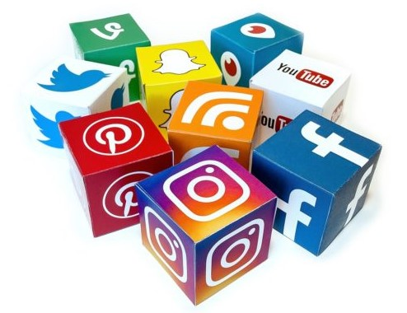
Background
Sentiment analysis is a technique used in classifying subjective text (or opinions) into positive, negative or neutral.
Common areas of Sentiment Analysis application (Beigi et al., 2016):
Estimation of product acceptance through reviews.
Stock market prediction
Prediction of event outcome (such as movie box office or general elections)
crisis management
User opinions can be found across all forms of online media but are largely underutilised due to it unstructured nature (Gundla & Otari, 2015)

Slide 3
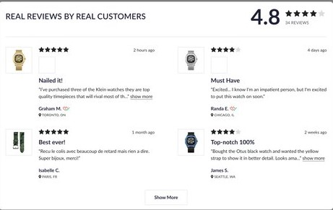
Research Significance
many researches on product reviews sentiment analysis have not really focused on strategies for communicating the results to aid decision making.
Insights from product review sentiment analysis will be better communicated with the aid of visualisation tools, especially to a non-technical audience.
It is an arduous task to read hundreds or thousands of public opinions about an entity and to classify them manually into the right category; positive, negative or neutral feedback.

Slide 4
Research Questions
Data visualisation is an important part of business intelligence that helps to make sense of data and display information in a comprehensive way (Few & Edge, 2007).
The use of data visualisation tools will facilitate better understanding and consequently aid decision makers in their product improvement strategies.
Research questions that need to be addressed are:
Are the results or efforts of product review sentiment analysis being maximised to aid decision making?
What specific data visualisation tools are most effective in communicating these results?

Slide 5
Goals and Objectives
Goal: To promote the benefits of using visualisation tools to present the results of product review sentiment analysis
Objectives:
To conduct a comprehensive review of effective data visualisation tools for product review sentiment analysis.
To recommend an effective visualisation tool and demonstrate its features.
To design a framework for integrating the results of product review sentiment analysis with the chosen data visualisation tool.
Table 1: Research Goals and Objectives

Slide 6
Literature Review
Mäntylä et al. in their 2018 journal, The evolution of sentiment analysis, note that sentiment analysis is a fast-growing research area which has received a lot of attention in the last 20 years.
Related Work
Gregory et al. (2006) proposes the use of the IN-SPIRE visualisation tool which is effective in extracting emotional contents of large datasets.
Beigi et al. (2016) went further by exploring the features of Pulse, VISA, TIARA, Eventscape and many other visualisation tools that perform similar work to the IN-SPIRE tool.
These tools offer more value to the analysts at the processing stage and do not provide the high-level content needed to aid decision makers.

Slide 7
Literature Review (….continued)
Gundla and Otari (2015) proposed a system for conducting review sentiment analysis and visualisation. In this paper, there was limited discussion on effective visualisation approaches.
Gandhe et al. (2018) proposes the use of python programming language for sentiment analysis visualisation
AlQahtani (2021) used python to achieve visualisation.
Whilst python serves as a good option, this research aims to extend to other available options.

Slide 8
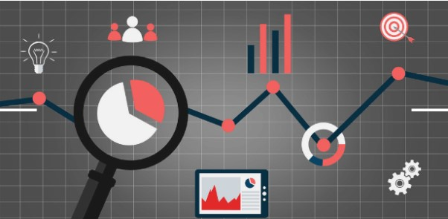
Literature Review (….continued)
Many research works fall short of emphasising the effective communication of product review sentiment analysis results using data visualisation tools.
Though the skills needed to analyse data differ from those needed to present the results in a convincing way (Murphy, 2013), a sentiment analysis project could fall short of its objectives if effective visualisation tools are not used.

Slide 9
Research Methodology
Theoretical Resources
Most of the resources utilised for the brief literature review study were drawn from google scholar. Other sources in scope include computing journal libraries, University of Essex computing library, visualisation tool providers such as python.org, r-project.org and tableau.com
Research Method
Quantitative approach: experiments will be conducted on four different visualisation tools and observations recorded.

Slide 10
Research Methodology (..continued)
Alternative Approach
Interviews / Surveys
it is expected that the challenges of communicating such technical results to the decision makers will be adequately revealed during interviews or via a questionnaire. However, addressing the bias which could arise from individual visualisation tool preference might be a challenge.
Research Limitation
Funding: free software available but limited in capabilities.

Slide 11
Risk Assessment
Risk | Impact | Mitigation
Delays | Medium | Longest amount of time allocated to the Data Gathering and Analysis activity
Abandonment due to cost. | Medium to High | Budget Provision
Table 2: Risk Assessment Matrix

Slide 12
Ethical Considerations
Licensed Software
Only up-to-date and licensed versions of visualisation software will be used in this research. These will be sourced from the official website of the software providers
Honesty, Integrity and Accuracy
This research will be conducted with uttermost honesty and integrity. Experiments will be conducted carefully and results will be presented with the highest level of accuracy.
Intellectual Property
Credits will be given to other research works that have paved the way for this one.

Slide 13
Research Artefacts
Framework Design
A framework will be developed to allow the integration of the sentiment analysis tool with the chosen data visualisation tool.
Software Demo
Video demonstration of how the visualisation tool is used to display sentiment analysis results will be done and lastly,
Screenshots emphasising key decision-making stats as presented by the recommended visualisation tool.

Slide 14

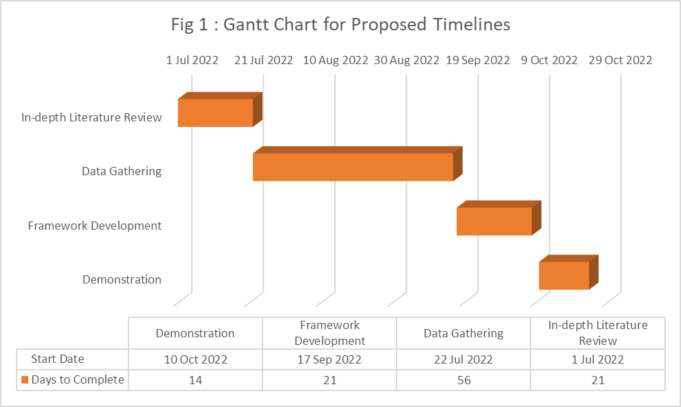
Proposed Timelines

Slide 15
Conclusion
In conclusion, this research is being conducted to address the important research questions outlined in slide 3. It is expected that machine learning practitioners, managers in ecommerce and decision makers will find the outcome beneficial.

Slide 16
References
AlQahtani, A.S. (2021) Product Sentiment Analysis for Amazon Reviews. International Journal of Computer Science & Information Technology (IJCSIT)13.
Beigi, G., Hu, X., Maciejewski, R. and Liu, H. (2016) An overview of sentiment analysis in social media and its applications in disaster relief. Sentiment analysis and ontology engineering. 313-340.
Few, S. and Edge, P. (2007) Data visualization: past, present, and future. IBM Cognos Innovation Center.
Gandhe, K., Varde, A.S. and Du, X. (2018) Sentiment analysis of Twitter data with hybrid learning for recommender applications. In 2018 9th IEEE Annual Ubiquitous Computing, Electronics & Mobile Communication Conference (UEMCON) 57-63. IEEE. November

Slide 17
References
Gregory, M., Chinchor, N., Whitney, P., Carter, R., Hetzler, E. and Turner, A. (2006) User-directed sentiment analysis: Visualizing the affective content of documents. In Proceedings of the Workshop on Sentiment and Subjectivity in Text. 23-30. July
Gundla, A.V. and Otari, M.S. (2015) A review on sentiment analysis and visualization of customer reviews, 4 :2062-2067.
Mäntylä, M.V., Graziotin, D. and Kuutila, M. (2018) The evolution of sentiment analysis—A review of research topics, venues, and top cited papers. Computer Science Review, 27: 16-32.
Murphy, S.A. (2013) Data visualization and rapid analytics: Applying tableau desktop to support library decision-making. Journal of Web Librarianship, 7(4): 465-476.

